Slide 1

INTELLECTUAL PROPERTY RIGHTS

Slide 2

Intellectual Property is that which results from the creation of intellect in industrial, scientific, literary or artistic field.
Intellectual Property
Intellectual Property Right (IPR) is the legally enforceable
exclusive right granted to the owner of the intellectual
property for a limited period
IPR can be assigned or licensed for financial benefits.

Slide 3
INTELLECTUAL PROPERTY RIGHTS
COPYRIGHT AND RELATED RIGHTS
INDUSTRIAL PROPERTY RIGHTS
PATENT
RIGHTS ON DESIGNS
TRADEMARK
PLANT BREEDER’S RIGHTS
GEOGRAPHICAL INDICATIONS

Slide 4
Intellectual Property Rights
Four main types of IPR:
Patents
Trade marks
Design Registration
Copyright

Slide 5
Patent
The word “Patent” comes from the Latin word “litterae patentes”, meaning an open letter.
A Patent is a statutory Instrument of monopoly granted as a reward :
- For An Invention
- By The Government
- To The Inventor
- For A limited Period.
In return for which the inventor has to disclose to the Public, his invention in its entirety.

Slide 6
Patent
Protection for new product, process, apparatus and uses
Provides patentee right to prevent anyone making, using, selling or importing the invention for 20 years.
Pharmaceuticals and plant products—patent extensions for up to 5 years = 25 years of patent life for original drugs
In many countries, scientific theories, mathematical methods, plant or animal varieties, discoveries of natural substances, commercial methods, or methods for medical treatment (as opposed to medical products) are not considered to be patentable subject matter.

Slide 7
STAGES - FILING TO GRANT OF PATENT
FILING OF APPLICATION
PROVNL. / COMPLETE
. TO BE FILED WITHIN 12MONTHS
PUBLICATION OF APPLICATION
AFTER 18 MONTHS FROM F.D.
REQUEST FOR EXAMINATION
EXAMINATION-ISSUE OF FER
3rd Party Representation
ALL OBJECTIONS TO BE COMPLIED WITHIN 12 MONTHS
GRANT OF PATENT
OPPOSITION
WITHIN 12 MONTHS
Decision of
Controller
Appeal
Appellate Board
Revocation/Amendment

Slide 8
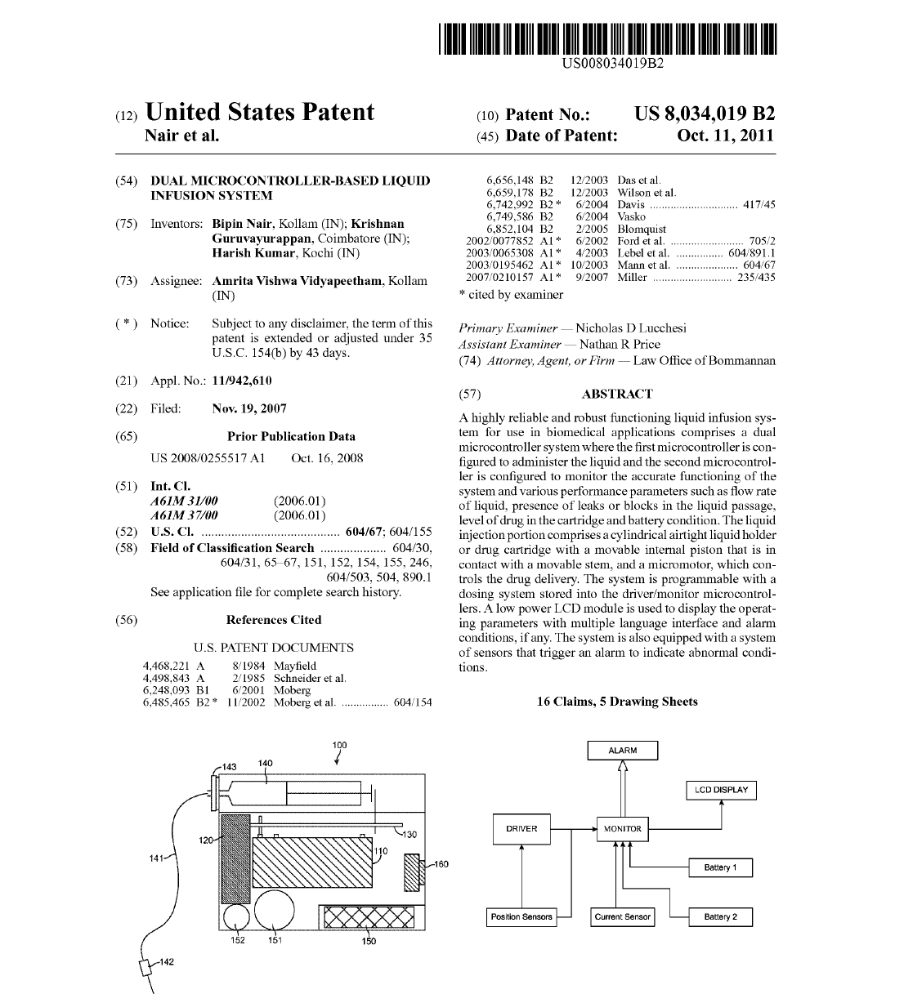

Slide 9
TERM OF THE PATENT
20 Years
From
Date of Filing of Patent Application
(Section 53)
DATE OF PATENT
The Date of the Patent Is the
Date of Filing Of the Application.
(section 45)

Slide 10
RENEWAL FEES
INDV NON INDV
3RD TO 6TH YEAR/YEAR @ Rs.500/- Rs.2000/-
7TH TO 10TH YEAR/YEAR@ Rs.1500/- Rs.6000/-
11TH TO 15TH YEAR/YEAR@ Rs.3000/- Rs.12000/-
16TH TO 20TH YEAR/YEAR@ Rs.5000/- Rs20000/-

Slide 11

Copyright
Aims at providing protection to authors (writers, artists, music composers, etc.) on their creations
literary works (novels, poems and plays)
Reference works such as encyclopaedias and dictionaries
Databases; newspaper articles
Films and TV programs
Musical compositions
Choreography
Artistic works (paintings, drawings, photographs and sculptures)
Architecture
Advertisements, maps and technical drawings
Copyright also protects computer programs.

Slide 12
Copyright
Copyright protection is obtained automatically without any need for registration or other formalities.
A work enjoys protection by copyright as soon as it is created.
countries provide for a national system of optional registration and deposit of works
Types of rights under copyright
(a) Economic rights, which allow the owner to derive financial
reward from the use and exploitation of the work
(reproduction, distribution, public performance, translation
& adaption)
(b) Moral rights, which highlight the personal link existing
between the author and the work (right to have authorship,
integrity)

Slide 13
Copyright
Copyright has a time limit: it usually lasts for the life of the author and 50 years after his death(in India it is 60 years)
Publication of excerpts needs acknowledgment. Material cannot be posted on a Web site without permission from copyright holder
Copyright is subject to limitations and exceptions - social, educational and other public policy considerations
International treaties, as well as national laws, allow to freely use limited portions of a work for certain purposes like:
- news reporting
- making quotations in a way compatible with fair practices
- illustration for teaching.

Slide 14
A symbol (logo, words, shapes, jingles) to provide a product or service with recognizable identity to distinguish from competing products.
TM protects distinctive components which make up marketing identity of brand including pharmaceuticals.
If registered nationally or internationally—use of symbol ®. Unregistered trademark followed by letters – TM
Trademarks

Slide 15
Trademarks
Trademarks may perform different functions:
- help consumers identify and distinguish products or services
- enable companies to differentiate between their products
- are a marketing tool and the basis for building a brand image
& reputation
- may be licensed and provide a direct source of revenue through
royalties
- are a crucial component of business assets
- encourage companies to invest in maintaining or improving quality
products
- may be useful for obtaining finance.

Slide 16
Trademarks
Efficient way of protecting a trademark is to have it registered – National / Regional trademark Office
Trademarks are territorial rights
A trademark owner is given the exclusive rights:
- to use the trademark to identify his goods or services
- to prevent others from using and marketing the same or a
similar trademark for the same or similar goods or services
- to authorize others to use the trademark, (e.g. by franchising
or licensing agreements) and in return for payment.
The period of protection varies (it is usually 10 years)
But a trademark can be renewed indefinitely on payment of the corresponding fees

Slide 17

TRIPS Agreement
Most important instrument to date concerning Intellectual Property Protection.
Introduced global minimum standards for protecting and enforcing nearly all forms of Intellectual Property Rights, including those for patents.
Minimum criteria for filing of patent applications
- novel
- involve an inventive step and
- are capable of commercial application

Slide 18
BIOPIRACY
Living resources or traditional knowledge and practices are patented
Resources primarily of developing countries -- patent applications by companies in developed countries.
Traditional Knowledge Digital Library - A tool for prevention of misappropriations of traditional knowledge

Slide 19
Ethics in Research
Ethics is concerned with the conduct of human beings.
Fundamental to understanding and applying ethical principles and guidelines is the concern for and
protection of the human rights of the participants.
All scientific activities are conducted with the
participation of human beings or have an impact on
human beings or on wider society and environment.
Essential that scientists/researchers understand
ethical issues and the implications of their
scientific work and act accordingly.

Slide 20
Basis for Ethics in Research
Four well-known moral principles constitute the basis for ethics in research. They are:
(i) The Principle of Non-maleficence: Research must not cause harm to the participants in particular and to people in general.
(ii) The Principle of Beneficence: Research should also make a positive contribution towards the welfare of people.
(iii) The Principle of Autonomy: Research must respect and protect
the rights and dignity of participants.
(iv) The Principle of Justice: The benefits and risks of
research should be fairly distributed among people.

Slide 21
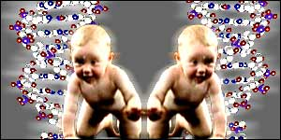
Contrary to morality
Human cloning
Human germ-line modification
Industrial or commercial use of human embryos
Genetic modification of animals causing suffering if no substantial medical benefit

Slide 22
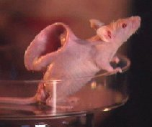
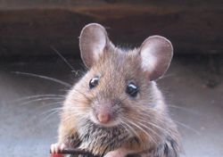
Contd...
NO
The naked mouse:
A transgenic mouse used to test hair products
YES
The Harvard Onco mouse:
Used as a model for studying cancer

Slide 23
Geographical Indications
Geographical Indications of goods are defined as that aspect of industrial property which refer to the geographical indication referring to a country or to a place situated therein as being the country or place of origin of that product

Slide 24
I have an innovation .... How do I protect it in the market ???
Copyright
Geographical Indications
Design Registration
Trademark
Patent
Trade Secret

Slide 25
WHAT TO DO, IF YOU INVENT ???
DON’T PUBLISH ANY WHERE BEFORE FILING PATENT APPLICATION
FILE PROVISIONAL / COMPLETE SPECIFICATION WITH APPLICATION
CHECK FOR TECHNICAL / COMMERCIAL VIABILITY
AFTER COMPLETE DEVELOPMENT FILE REQUEST FOR EXAMINATION (WITH IN 36 MONTHS)
GET PATENT
COMMERCIALIZE (MAKE, SELL, LICENSE, ASSIGN)
FIELD WATCH (REGULAR SEARCH OF PATENT / NON PATENT DOCUMENTS & OTHER NEWS FROM INDUSTRY

Slide 26
Take Home Message
Patent systems are not created in the interest of the inventor but in the interest of national economy. The Rules and Regulations of the Patent systems are not governed by civil or common law but by political economy – P J Michael

Slide 27



